Slide 1
Arduino Workshop #2
Digital and Analog Inputs
Notes:
24 – Arduino Uno
24 - Small bread board
24 – Jumper wire sets
24 - 10 kΩ potentiometer
48 – 10 kΩ resistor
72 – 220 Ω resistor
24 – USB cables
24 – photoresistors
24 - TMP36 temperature sensor (or any other 5 V analog sensor)
24 – 5mm common-cathode RGB LED

Slide 2
Reading Digital Inputs

Slide 3
PowerPoint and Code
Github.com/EELabMan
Go To Repositories and find Arduino 2 Digital and Analog Inputs

Slide 4
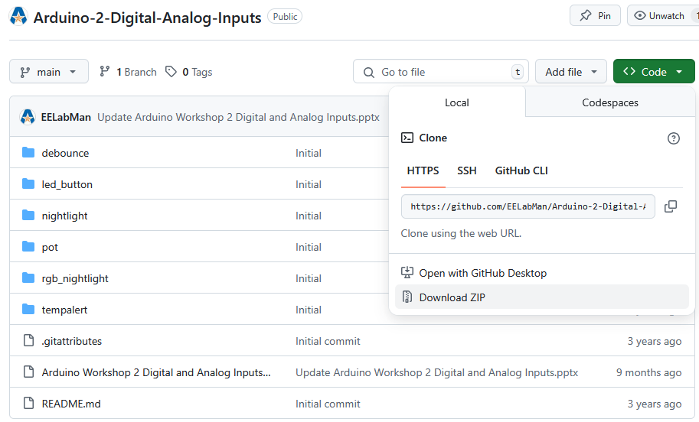
PowerPoint and Code
Click the GREEN code button and download the ZIP folder. BE SURE TO UNZIP THIS FOLDER.

Slide 5
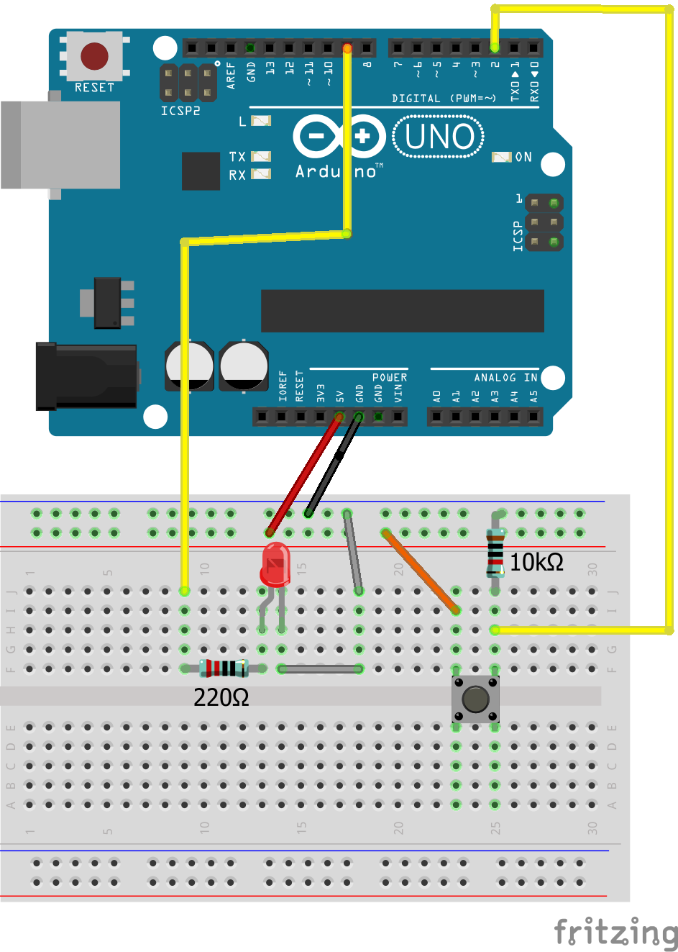
Wire diagram
Try to follow the breadboard layout
exactly.
For example : Pin 9 from the Arduino should be connected to Row J Column 9 of the breadboard.
Use male-to-male jumper wires for connecting the Arduino Uno and the breadboard.
You will use precut breadboard wires (Usually on top of the lab benches) to make the connection from the LED Cathode (Negative) Row F Column 14 to Row F Column 18.
Then use a male-to-male jumper from Row J Column 18 to the Top rail. Jumper that rail to the Uno GND pin.

Slide 6
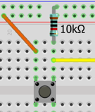
Pull down resistor
Notice the resistor running from the button to the ground rail
This is a 10KΩ pull down resistor
The 5 v Power Rail can run two paths
When the button is not being pressed:
The button is open and ALL the voltage is dropped across it. So, the resistor is at ground potential.
Logic zero going to digital input 2.
When the button is pressed:
The button becomes a short or 0 ohms. So, ALL the voltage is dropped across the resistor.
Logic 1 going to digital input 2.
This insures that
The button does not create a short
The input pin is never in a “floating” state. Only 5V or 0V, no in-between.

Slide 7
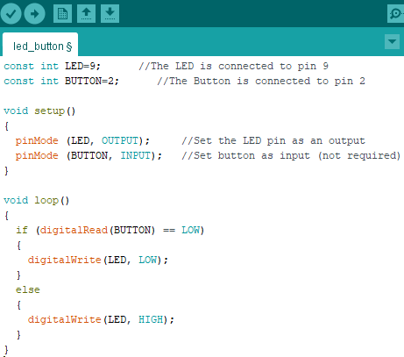
Download led_button.ino
LED is assigned to pin 9 as a constant integer
BUTTON is assigned to pin 2 as a constant integer
In Setup, LED is set as an output, and BUTTON is set to an input.

Slide 8
IF ELSE Statements
If button is
Not being pressed
digitalRead() returns LOW
The if statement is executed (True) and the LED is set to 0V.
Being pressed
If statement is not “True”, the if statement is not executed and the else statement is executed so digitalWrite set the LED to 5V.
When was the last time you had to hold the button down to keep a light on?
Let’s fix that.

Slide 9
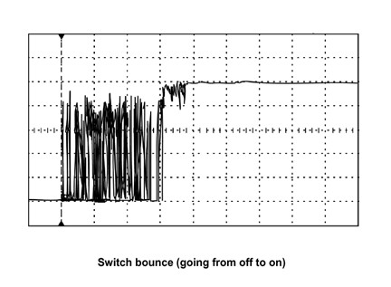
Bouncy buttons
Bouncy button means when you press the button the volatge bounces up and down before it settles to the high state.
This would turn something on and off several times.
We can program a small delay to help combat this issue.

Slide 10
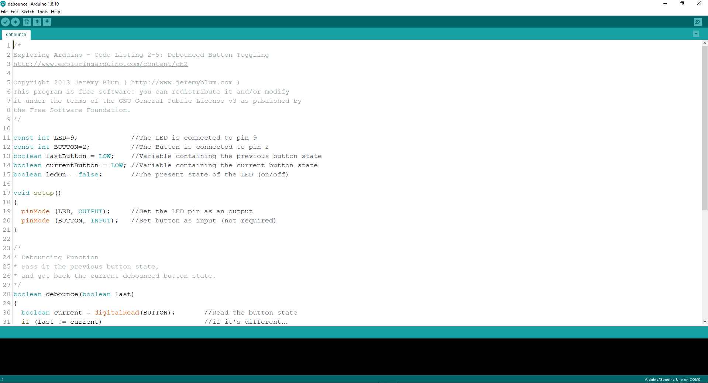
Open debounce.ino
Upload to the Uno and test the button for bounciness

Slide 11
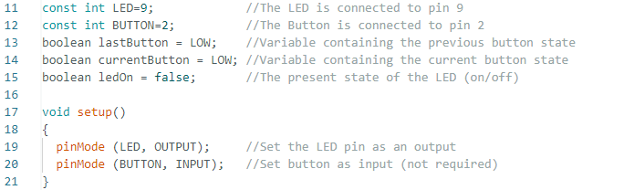
debounce.ino code walk through
You have seen most of this code before. But now we have a new data type called Boolean. This data type can only be TRUE “1” or FALSE “0”. The Arduino IDE interprets LOW as false and HIGH as true.
So, we have three Booleans, lastButton which stores the state of the previous button state, currentButton which stores the current button state and ledOn which holds the present state of the LED.

Slide 12
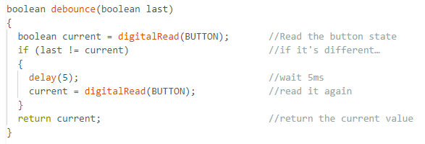
debounce.ino code walk through
Before the main loop begins, we have added a custom function called debounce.
The Boolean before the name debounce is the return type. You can see the return current at the end of the function, this is the Boolean that goes before the name.
The Boolean last after the name debounce is an input parameter named last inside the function. We pass the lastButton variable into this last parameter.
The rest of the function adds a 5-millisecond delay in reading the button state.

Slide 13
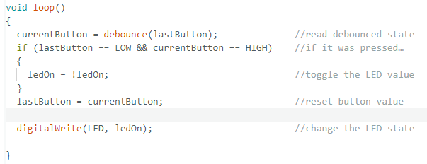
debounce.ino code walk through
The debounce function is ran and the return value is assigned to currentButton.
The if statement compares the value of the lastButton and the currentButton. Each time the button is pressed the lastButton should be 0 and the currentButton will be high “1”. lastButton is set to ledOn, which is now high, and the LED is turned on.
When the debounce is ran again the lastButton becomes 0 and then current is set to 0 again until another button press.

Slide 14
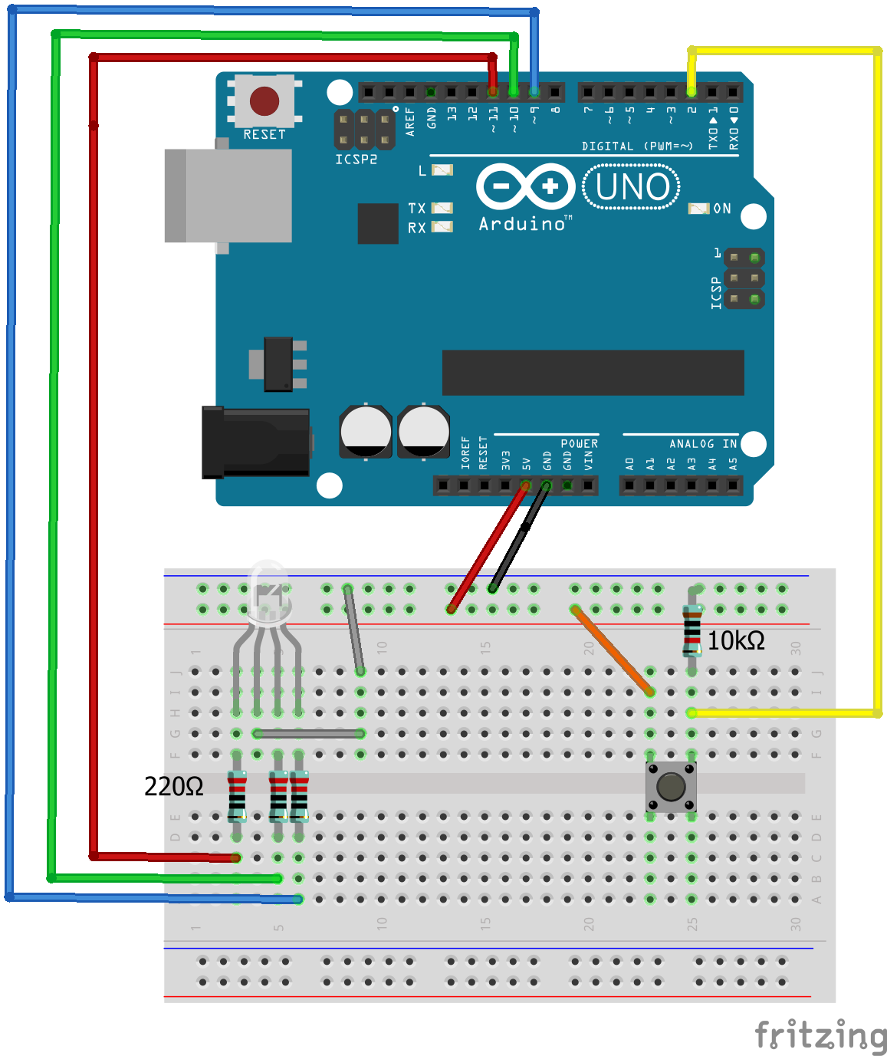
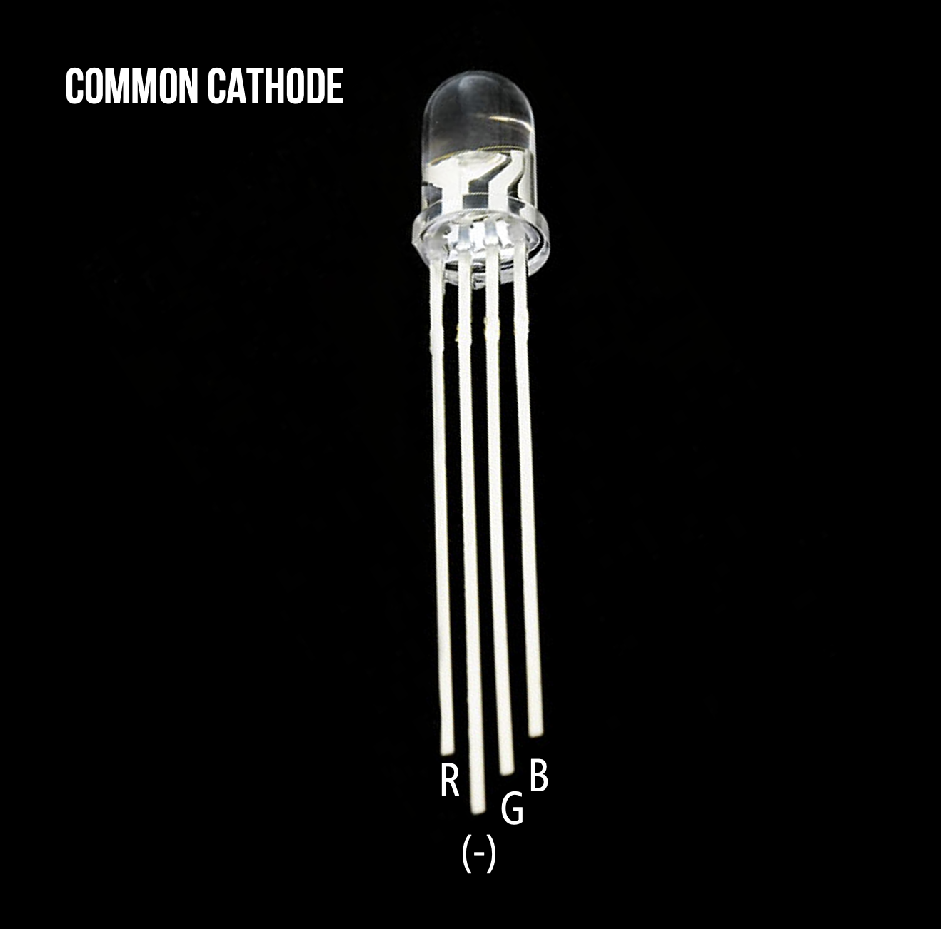
Let’s switch out the RED LED with a RGB LED. These are common cathode, so the negative lead needs to go to ground. The cathode or negative lead is the lond lead this time. RED -> pin 11 GREEN -> pin 10 BLUE -> pin 9
RGB LEDS

Slide 15
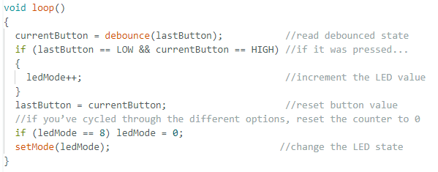
Rgb_nightlight code
Upload to Arduino and test its function.
What’s new in the code
Besides adding a green and blue LED, we added a ledMode interger and initialized it to 0.
Instead of toggling the RED LED like before, we increment the ledMode with a “++”
When ledMode is equal to 8 it is reset to 0.
ledMode value is passed to the setMode function.

Slide 16
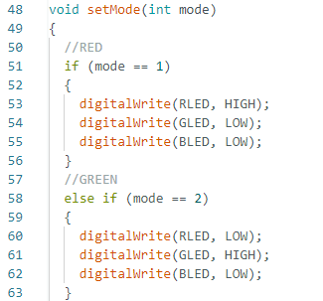
setMode function
The ledMode value is sent to the setMode function and is now called mode
There are 8 different if statements. One for each of the mode values 0-7
The first 3 just turn on either the red, green or blue LEDS using digitalWrite.
The other sets a PWM value for each of the red, green and blue LEDS using analogWrite. Setting these values can give you all the colors.

Slide 17
Reading Analog Sensors

Slide 18
Why we still need analog in a “digital world”?
Observable features are analog
they can assume any number of potential states
Color of sunlight
Temperature
Concentration of contaminants in the air
So we need a way to distinguish between analog and digital inputs and convert between the two

Slide 19
Analog to digital converter (ADC)
Suppose you want to measure the brightness of the room (measured in lux - it could be any decimal from 0 to ∞)
Pitch black - output 0 volts
Completely saturated - outputs 5 volts
Half saturated - outputs 4.5 volts
⅓ saturated - outputs 1.6666 volts
etc.
You need to use the analog to digital converter (ADC) built into the Arduino to read this value

Slide 20
But what is a ADC doing?
In the Arduino UNO
10-bit ADC
This means that the ADC can subdivide (or quantize) an analog signal into 2¹⁰ different values
2¹⁰ = 1024 ( 0 to 1023)
So from the reference voltage (5 v)
2.5 v is mapped to 512 (½ of 1024)
1.25 v is mapped to 256 (¼ of 1024)
etc.

Slide 21
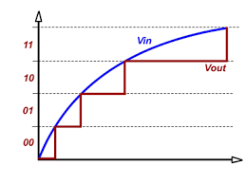
Visual of what’s happening
Here is a 2 bit ADC, it has 2 bits of resolution and therefore 4 total logic levels (2² = 4)
The higher the resolution the more “steps” in the digitized signal (remember the Arduino has 10 bit resolution… so 1024 steps)
As you can see, a 2-bit ADC is not very accurate.

Slide 22
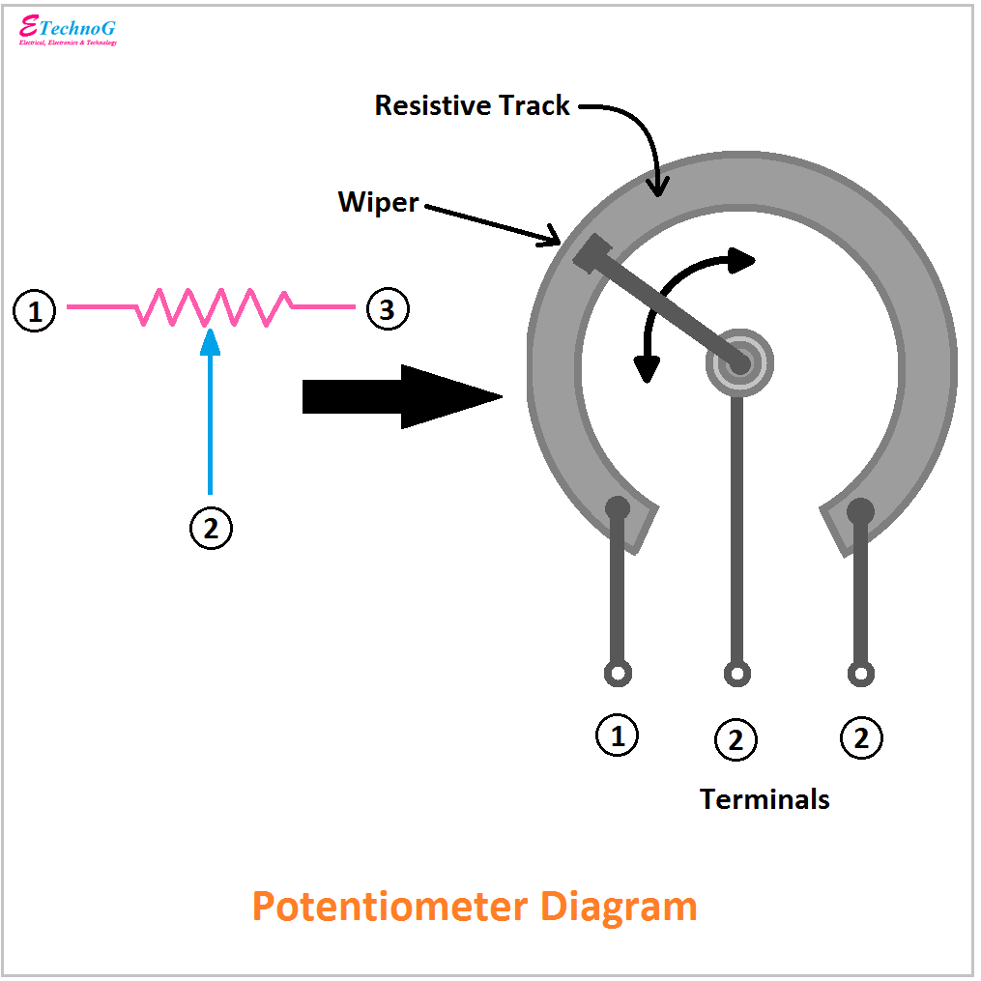
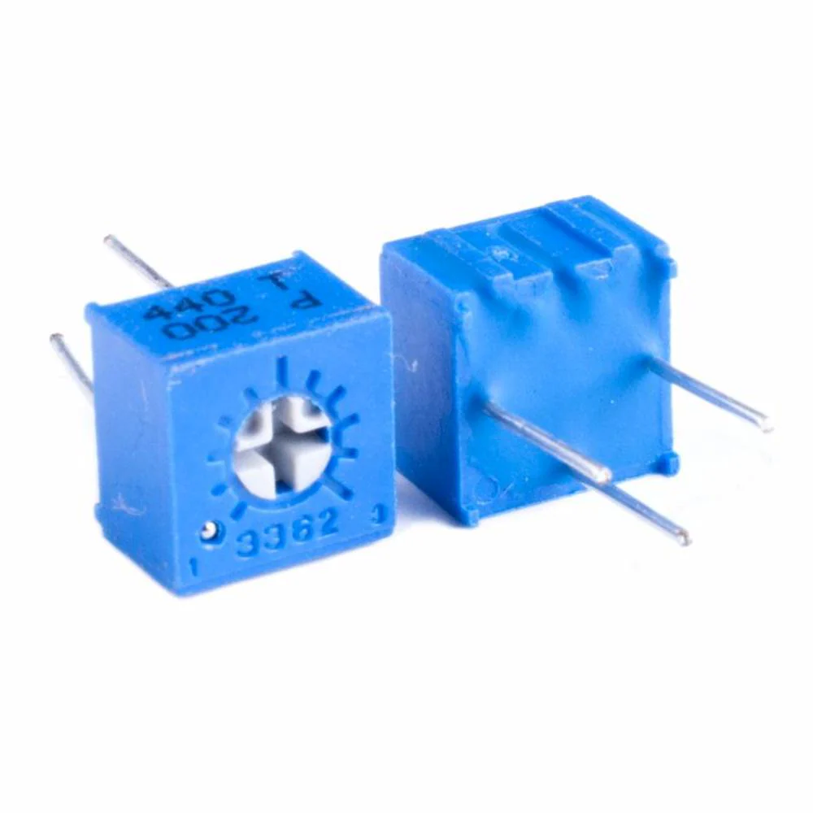
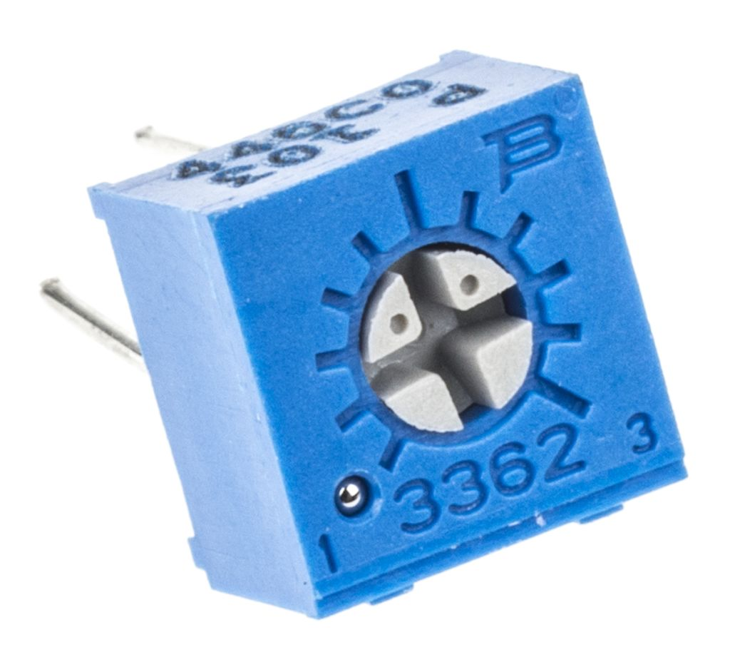
Reading analog signals
Let's start with a potentiometer
Pot for short
Used in
car stereos
Thermostats
speakers
Etc.
3 pins
One outer pin is grounded (symmetrical so it doesn't matter which side)
The other side pin is connected to high (5 v)
The center pin is connected to ADC input – The output
As you turn the knob you are changing the resistance and thus the output voltage (by ohm's law) to any value between 0 v and 5 v

Slide 23
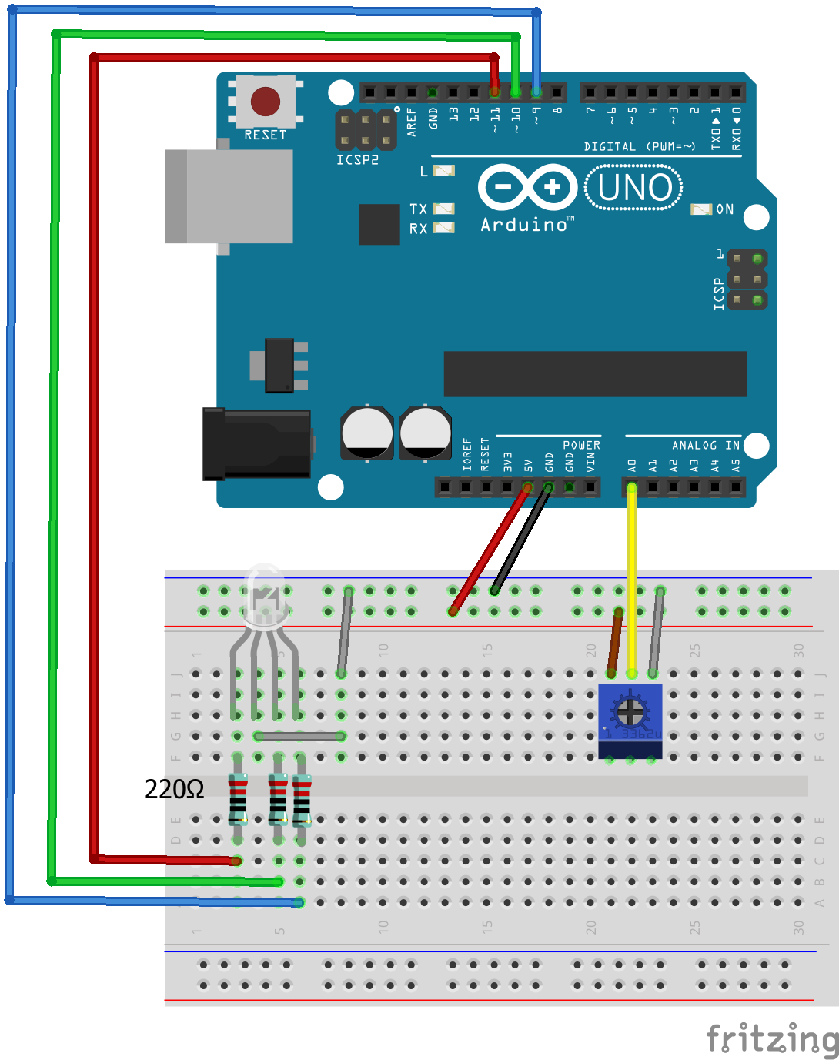
Lets wire up a circuit
Ensure the middle pin of the potentiometer is in row G column 22. In line with the yellow jumper going to the Arduino A0 pin.

Slide 24
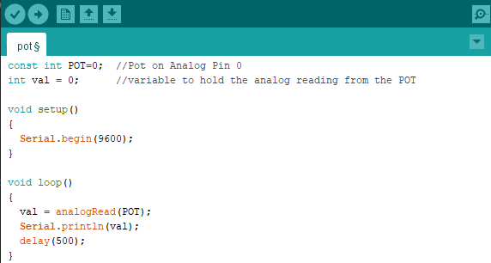
Open pot.ino and upload

Slide 25
Notice the new functions
analogRead()
This function reads the value of the analog pin connected to the Arduino
Serial.println()
This function prints to the Arduino IDE serial monitor
serial.begin()
In the setup section
Takes an argument that specifies the communication rate (baud rate)
Faster baud = more data in less time
Can induce transmission error
9600 is common value (and will be the standard we use)

Slide 26


What you should see
The TX LED on the Arduino should be blinking every 500 ms
This indicated the Arduino is transmitting data
If you are getting “funky data” you need to ensure the baud rate is correctly set on the monitor and the Both NL & CR are selected.
Serial Monitor
New Line and Carriage Return and baud rate

Slide 27
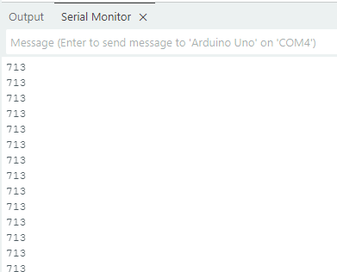
What you should see
After launching the serial monitor you should see a window w/ numbers streaming by
Turning the potentiometer with the small screwdriver and the numbers should go up and down
One way goes toward 0, this indicates 0 volts is on the Analog 0 pin.
The other towards 1023, this indicates 5V on the Analog 0 pin.

Slide 28
Use an analog sensor to sense temperature

Slide 29

Wire it up
CAUTION!
Flat side of TMP36
faces toward you!
If it’s not, it will burn your fingers soon!
Flat side

Slide 30
Before we can begin
We need to find what ADC value corresponds to “ROOM TEMPURTURE”
Let’s break down what voltage corresponds to 1 ADC value
5V / 1024 is 0.00488 Volts per ADC value. So for every 0.0048V you get 1 DAC value increase.
20°/143 is 0.1399. So each degree Celsius correspondes to 0.1399/.0048 or ~30 DAC values
So to make the green LED light turn on, subtract 60 DAC values and add to the code
To make the RED LED light turn on, add 60 DAC values and add to the code

Slide 31
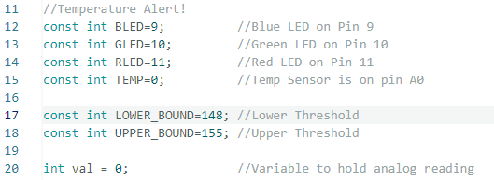
Open tempalert.ino and upload it
We have the standard Red, Green and Blue LED pin assignments
We have an integer variable named TEMP to store the A0 pin value
We also have two constant integer values names LOWER_BOUND and UPPER_BOUND. We’ll come back to those.
There is also an integer variable ( Not constant because we must update it ) named val.

Slide 32
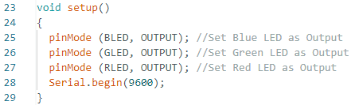
Setup()
Here we set the LEDs to outputs and initialize the serial connection to 9600 baud.

Slide 33
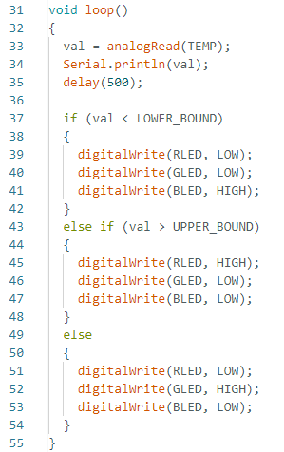
Loop()
First, we do an analogRead of pin A0 (TEMP) and assign it to val
Next, we print val to the serial monitor.
Then we have an if statement. If val is less than LOWER_BOUND the Blue LED will turn on.
Then we have another conditional “else if” statement. Always use else if after if statements for conditional else. If the val ADC is greater than the UPPER_BOUND, the RED LED is turned on.
Lastly, the else statement is the default action if the if or else if statements are not true.

Slide 34
Calibrate the ADC Values
Open the serial monitor and see what the ADC value is for “room temperature”.
Add 4 to your ADC value and update the LOWER_BOUND to that number.
Add 4 more to that value and update the UPPER_BOUND to that number.
Squeeze the TMP36 with your fingers to heat it up! It should turn Green and then Red!
Update these two numbers in the code and “re-upload” the code

Slide 35
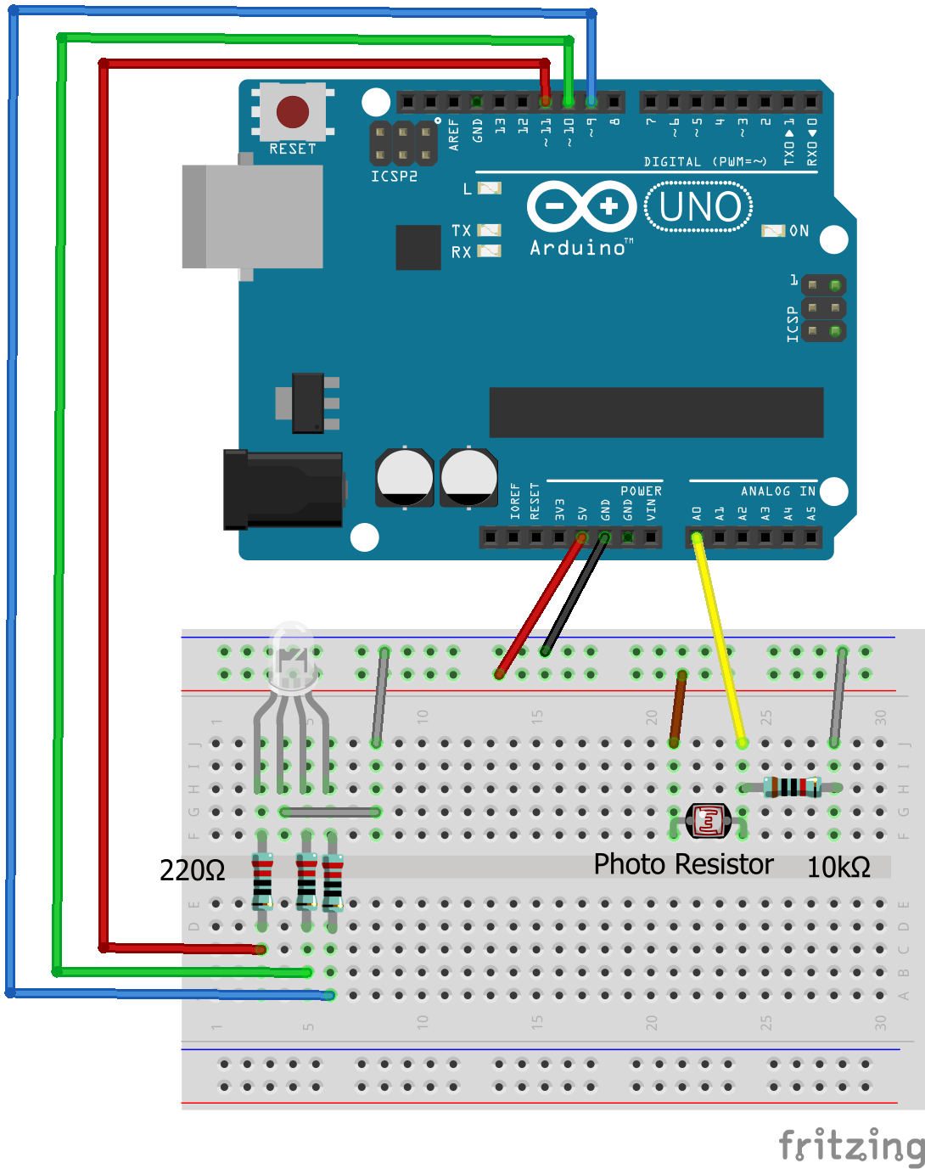
Add the Photoresistor
Insert the Photo Diode into Analog In 0

Slide 36
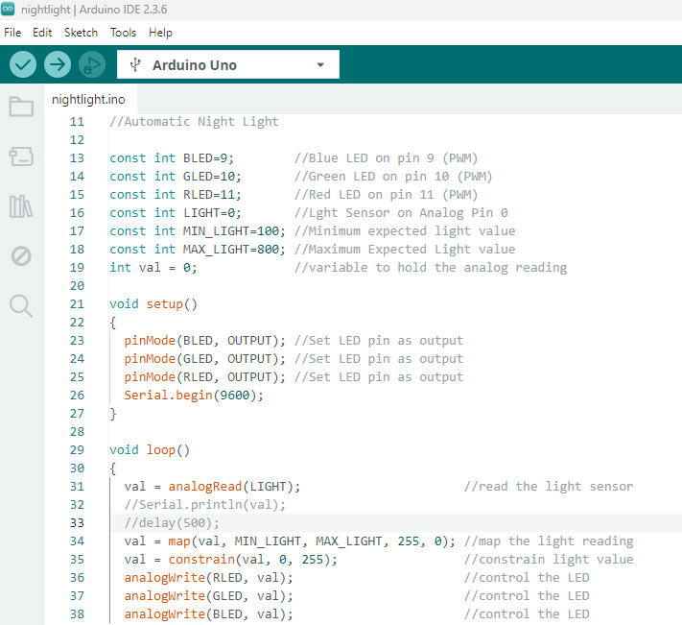
Open nightlight.ino and upload
Cover the photoresistor with your hand.
Leds and Analog pin 0 “ LIGHT” are assigned to pin numbers as constant integers
Min and Max values are set
Val integer is set to 0 to hold the LIGHT reading
LED are set to outputs
Serial monitor is enabled
Read voltage and assign ADC to val
MAP and CONSTRAIN – NEXT SLIDE
R, G and B LEDs sent PWM from this NEW ADC value

Slide 37

New function
map()
Output = map(value, fromLow, fromHigh, toLow, toHigh)
Value - the information you start with
Most recent reading from analog input – Remember val (any ADC) goes from 0-1023.
fromLow and fromHigh
Input boundaries
Min is set to 100 and Max is set to 800
toLow and toHigh
Values you want to map to
255 and 0 (swapped to turn off the light when bright)
constrain()
constrain(value, min, max)
Constrains the value given between 2 values
If the photo resistor measured to high you would pass below 0 (its inverted to turn off in light)

Slide 38
Clean up
Disassemble the breadboard and wires for the next student and place it all back in the bag.
Return the bag to the lab manager.

Slide 39
Stay tuned
Arduino 3 will cover Motors, H-Bridges and Servos.

